Slide 1
NCICB Common Security Service
Phase 2 Kickoff
6/28/2004
Kalpesh Patel (patelk@mail.nih.gov)
Vinay Kumar (kumarvi@mail.nih.gov

Slide 2
Agenda
Introduction
Background & Scope
Requirements
High level Architecture – not complete
Overall approach
Initial Milestones
Project Startup Items
Project Management
Risks
Next Steps

Slide 3
Background & Scope
Phase 1
  Authentication
  Authorization
Phase 2
  Review phase 1 artifacts
  Review proposed schedule
  Iterative implementation

Slide 4
Requirements
Review of use cases from Phase 1
Architectural System Design
  Authentication
    User to system authentication
    System to system authentication
  Authorization
    User authorization model
    User authorization data
  Account Management & User provisioning
  Single Sign On
    Seamless transfer of authentication credentials allowing a user to navigate the system with a single ID
    Seamless transfer of authorization credentials from one system to another
    Honoring of authentication and authorization between the systems
  Message security
    Secure the messages between user to system
  Secure the messages between system to system
  HIPPA Compliance

Slide 5
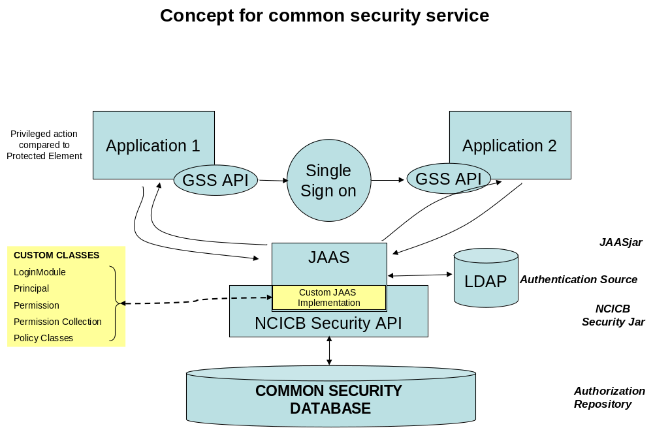
Overall Architecture – high level

Slide 6
Authentication & Authorization
Leverage Phase 1 work
Leverage work from existing projects
Architecture
  Implement JAAS Interfaces
    Leverage multiple authentication sources
      PAM – Pluggable authentication modules
    Leverage multiple authorization sources
    Hide the sources from applications
    Integration with GSS & Kerberos

Slide 7
NCICB Security Model (without the log relationships)
User
Application
Privilege
Log
Protection Group
Type
Application
Privilege
Protection
Element
Role
Protection Group
Role privilege
Elements Used
In C3PR
Application
Protection
Element
Application
Protection
Group
C3PR Done
C3PR, not in scope
Protection Group Element
Protection type
User Role Protection Application

Slide 8
Single Sign On
Option 1
  Use JAAS with Java GSS and Kerberos
Option 2
  Leverage reuse of NCI-ISCS implementation
Option 3
  Leverage Apache auth_ldap (assumes that Apache is used everywhere)
Option 4
  Central Authentication Server Architecture developed by Yale
Leverage SAML
  OpenSAML – SAML 1.0 and 1.1 compliance

Slide 9
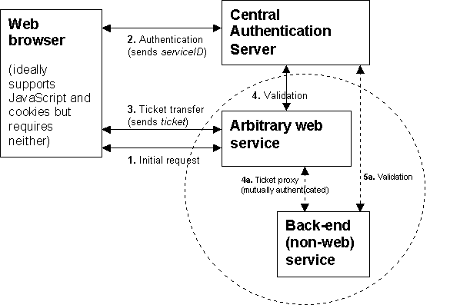
Central Authentication Server

Slide 10
WebServices/ Message Security
Key Requirements
  Data Integrity
  Confidentiality
Technologies
  Transport level security
    SSL
    TLS (Transport Layer Security)
  Message level security
    XML Digital Signature (JSR 105)
    XML Encryption (JSR 106)
    XKMS (XML Key Management Specifications)
      XKISS (XML Key Information Service Specification) –Validation of public keys contained in document
      XKRSS (XML Key Registration Services Specification) – Trust services for PKI clients such as key validation, registration, recovery, revocation etc.
    XACML (eXtensible Access Control Markup Language)

Slide 11
Architecture Goals
Performance
Scalability
Maintainability
Reuse
Packaging and distribution
Backward compatibility through iterations
Open source
Reference Implementation

Slide 12
Architectural Goal - Reuse
Phase 1
NCICB Applications
ISCS – NCI LDAP
NIH Investments
  Over 40,000 registered external users at NIH – some of them may be the same users for your applications
    User Registration
    Account Management
  NIH PKI infrastructure
eAuthentication citizen services

Slide 13
Project Management
Process
  Rational Unified Process
  Peer review of requirements and technical deliverables
Roles and Responsibilities
  Kalpesh Patel – PM
    Primary POC, Project planning
    Deliverable and risk management
  Vinay Kumar – TM & Architect
    Requirements gathering
    Software architecture and design
SWG Members
  Requirements communication and signoff
  Validation of the technical approach
  Bring new ideas for implementation
  Participate in the prototype verification
  Participate in integration and pilots
  Participate in the deployment and change management

Slide 14
Overall Process
Iterative RUP Approach
Interactive with technical group
Prioritize requirements into iterations
Define scope for each iteration
Get concurrence of the plan & iteration
Delivery and integration with application teams

Slide 15
Inception
Set up the computing infrastructure and physical plant for the project
Review the existing use cases, models, designs and all existing documentation
Revise proposed project plan and submit draft and final project plans
Develop the scope document with use case inventory
Draft technical architecture for each phase of deployment
Determine with NCICB what deployable units will be and in which sequence they will be build
Identify the appropriate open source technologies and open standards that the common security service can leverage

Slide 16
Elaboration
Goal – Reduce the risks
  Architectural Risks
  Business Risks
Complete the use case analysis and document the complete set of system security requirements
Identify high risk use cases & requirements
Prototype critical component of the system
Refine and complete the common security service architecture components
Release the first deployable common security service for use at NCICB

Slide 17
Construction
Quick delivery by reuse of Phase 1, C3PR and other NCI work
Gradual expansion to full model in iterations

Slide 18
Construction Approach
Review requirements for the planned iteration including changes from previous iteration
Use case realization and detailed design or design revision-update
Review Design based on UML models with NCICB and peers
Test plan development
Prototype of critical components – proof of concept
Development of code for all requirements
Development of drivers for testing and use of testing tools
Integration test scenarios and integration test using test tools
Support other application teams in integration
Deployment with one or more applications as Pilot in staging area
Deployment with one or more applications as Pilot in production
Support of deployed code base, monitoring of issues
Maintenance fixes through the CM board

Slide 19
Construction Outcome
Functioning, tested code
Source code, jar/ear files, configuration files, installation script
Java API documentation: How to use the service
User documentation where applicable: User and data management module
Code documentation JAVADOC to be used extensively
Test plan, test scripts, test report

Slide 20
Transition Phase
Coordination of tests and pilots with other teams
Support of integration of common service in other applications
Specific assistance in HIPAA compliant implementations including business process flows
Support during integration and deployment of other applications
Monitoring of help desk calls and update of FAQ documentation
Participation in the CM process for caCORE and C3D components
Maintenance and changes during the scope of this task

Slide 21
Proposed Iterations
Iteration 1: Deployable common module for stand alone applications
Iteration 2: Deployable module with service interface and multi-application authorization
Iteration 3: Complete solution to deploy applications including the common service
Iteration 4: Multi J2EE application common service HIPAA compliant
Iteration 5: Integration of messaging component and multi-site deployments, non-J2EE legacy applications

Slide 22
Iteration 1:
Goal : common module for stand alone applications
Use authorization model
Reuse Phase 1, and other potential work from NCICB applications
Deployable unit
  Candidate deployment apps
    CSAERS
    Form 54 – ADT
    C3PR

Slide 23
Iteration 2:
Goal: Pilot the concept of common security service based on a shared authorization repository
Add concept of “application”
The JAAS implementation layer for the authentication and authorization service

Slide 24
Iteration 3:
Goal: Add the management features of the common security service
User Management
Broader deployment
the system management features
  audits and alerts
  some reports for system activity management

Slide 25
Iteration 4:
Goal: Make changes from the feedback of integration
Address changes from the integration experience
Application – Application Security
Address HIPPA issues

Slide 26
Iteration 5:
Goal: System to System security
Revise and refactor as needed
SAML, CSS etc.
Support messaging infrastructure

Slide 27
Project Startup
Application level meeting
  Understand application requirements
  Review schedules

Slide 28
Initial Milestones
Inception
  Project Approach
  Project Plan
  Use Case Survey – Level 1 Use Cases
  Review of Phase 1 artifacts
  Mapping of Phase 1 design to our proposed approach
  Revised project approach with NCICB input

Slide 29
Risks
caBIG architecture not fully defined
No standardized tool set at NCICB
Access to NCI LDAP may be too limiting for caBIG
Reluctance to store authorization information in a common database
caBIG architecture will evolve
Change Management for this project

Slide 30
Next Steps
Meeting with project teams
Review phase 1 artifacts
Draft Project Plan
Review schedule and obtain input from NCICB
Get consensus from the SWG on the plan and approach
Next meeting

Slide 31
Questions

